Slide 1
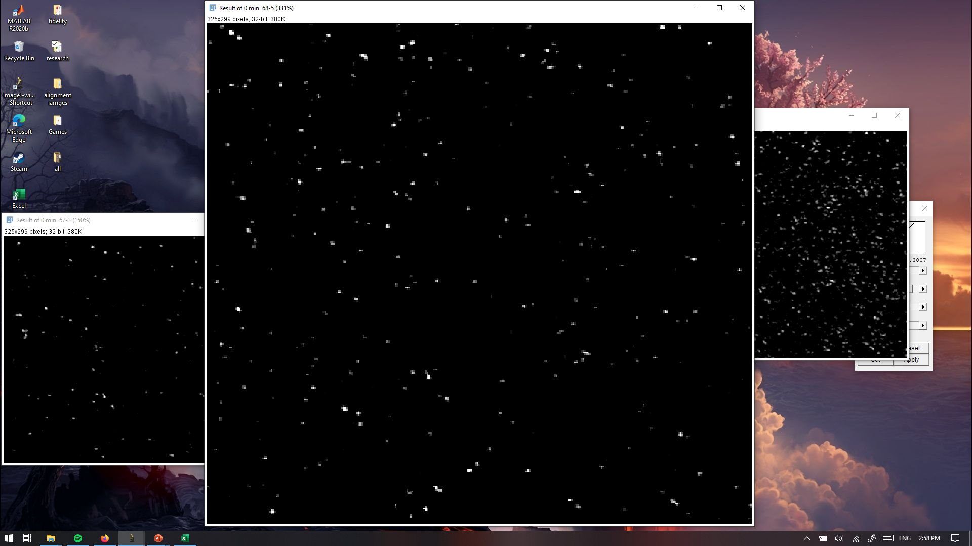

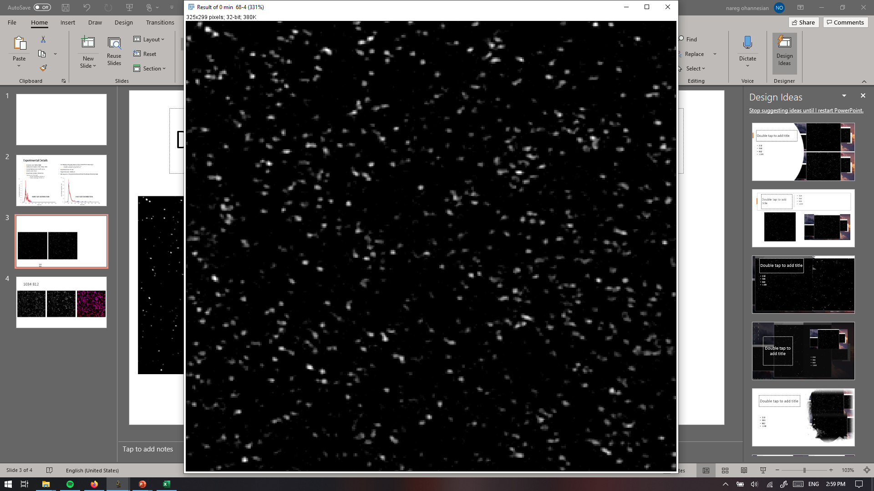
PANORAMA of H460 Exosomes
PANORAMA
Time: 30 min
Count: 811
PANORAMA
Time: 45 min
Count: 1097
PANORAMA
Time: 15 min
Count: 344
Scale bar: 10 µm

Slide 2
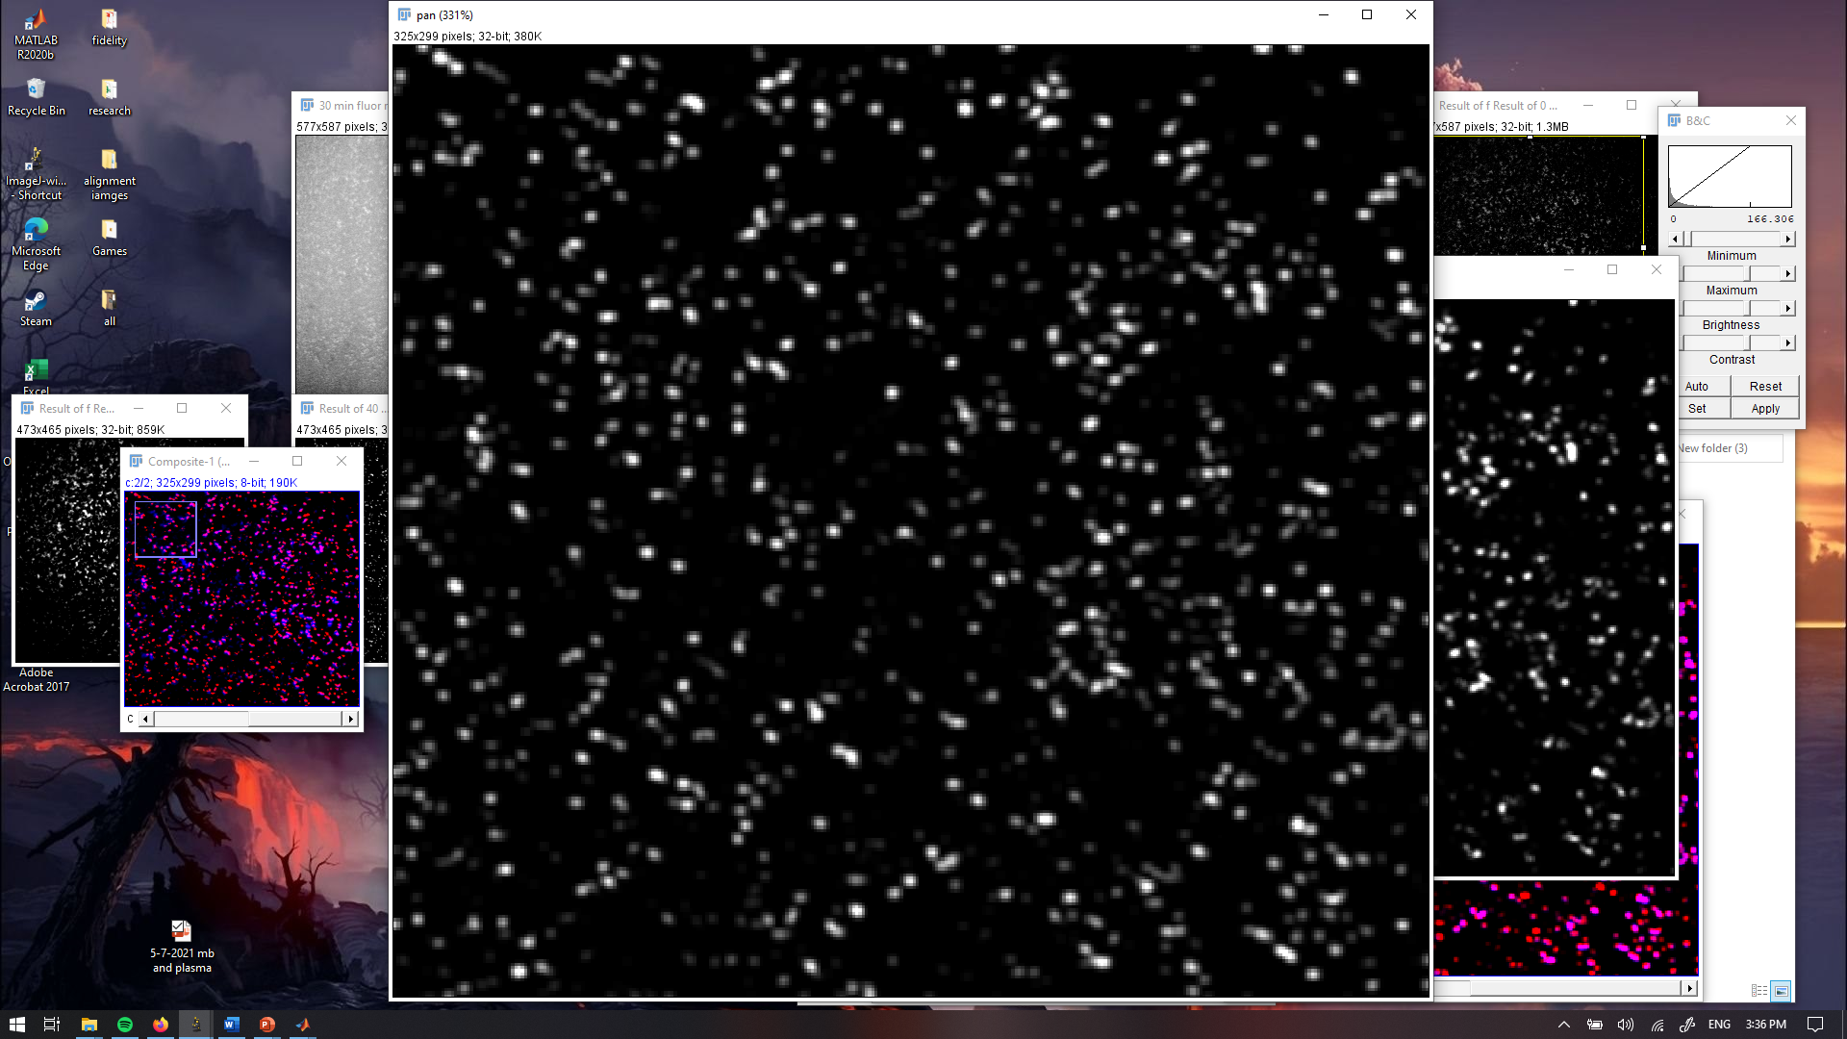
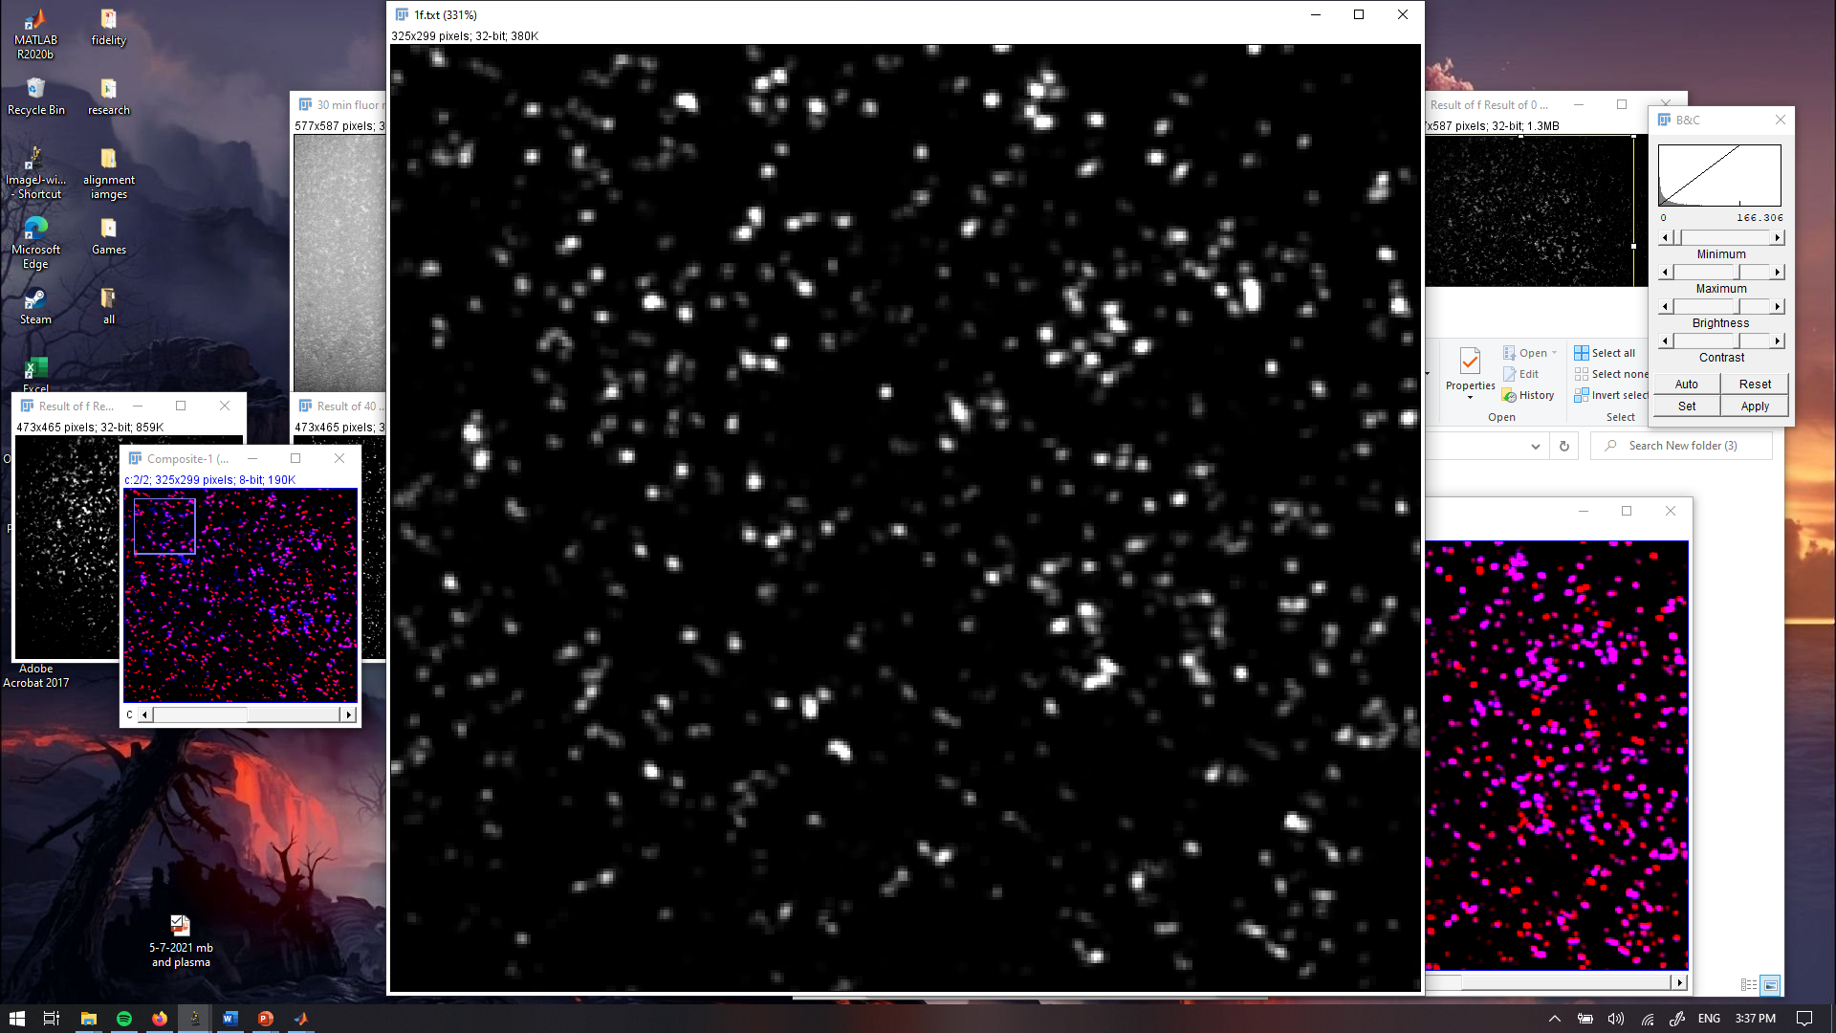
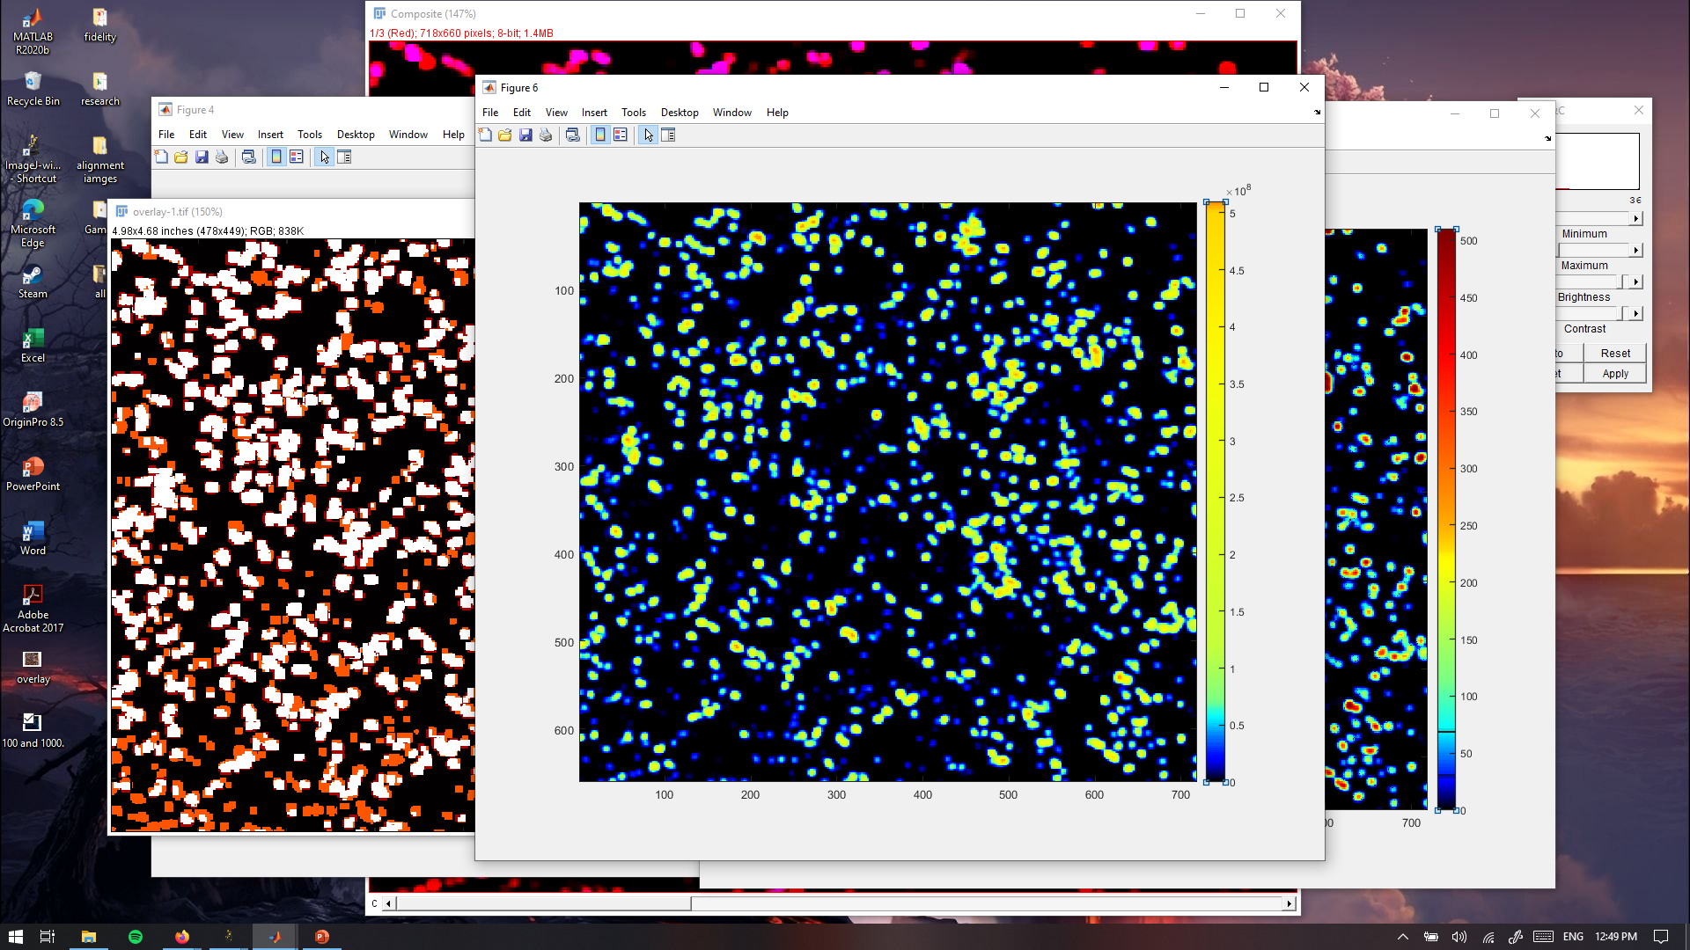
PANORAMA and Fluorescence of H460 Exosomes
PANORAMA (IR: 1.12 ± 0.048)
Time: 45 min wash
Count: 1034
Fluorescence (370 ± 129)
Time: 45 min wash
Count: 812
Overlayed
Blue: PANORAMA
Yellow: PANORAMA and fluorescence
94 % of detected exosomes captured after wash
77 % of detected exosomes show mir-21
All fluor have a PANORAMA detected point
Scale bar: 10 µm

Slide 3
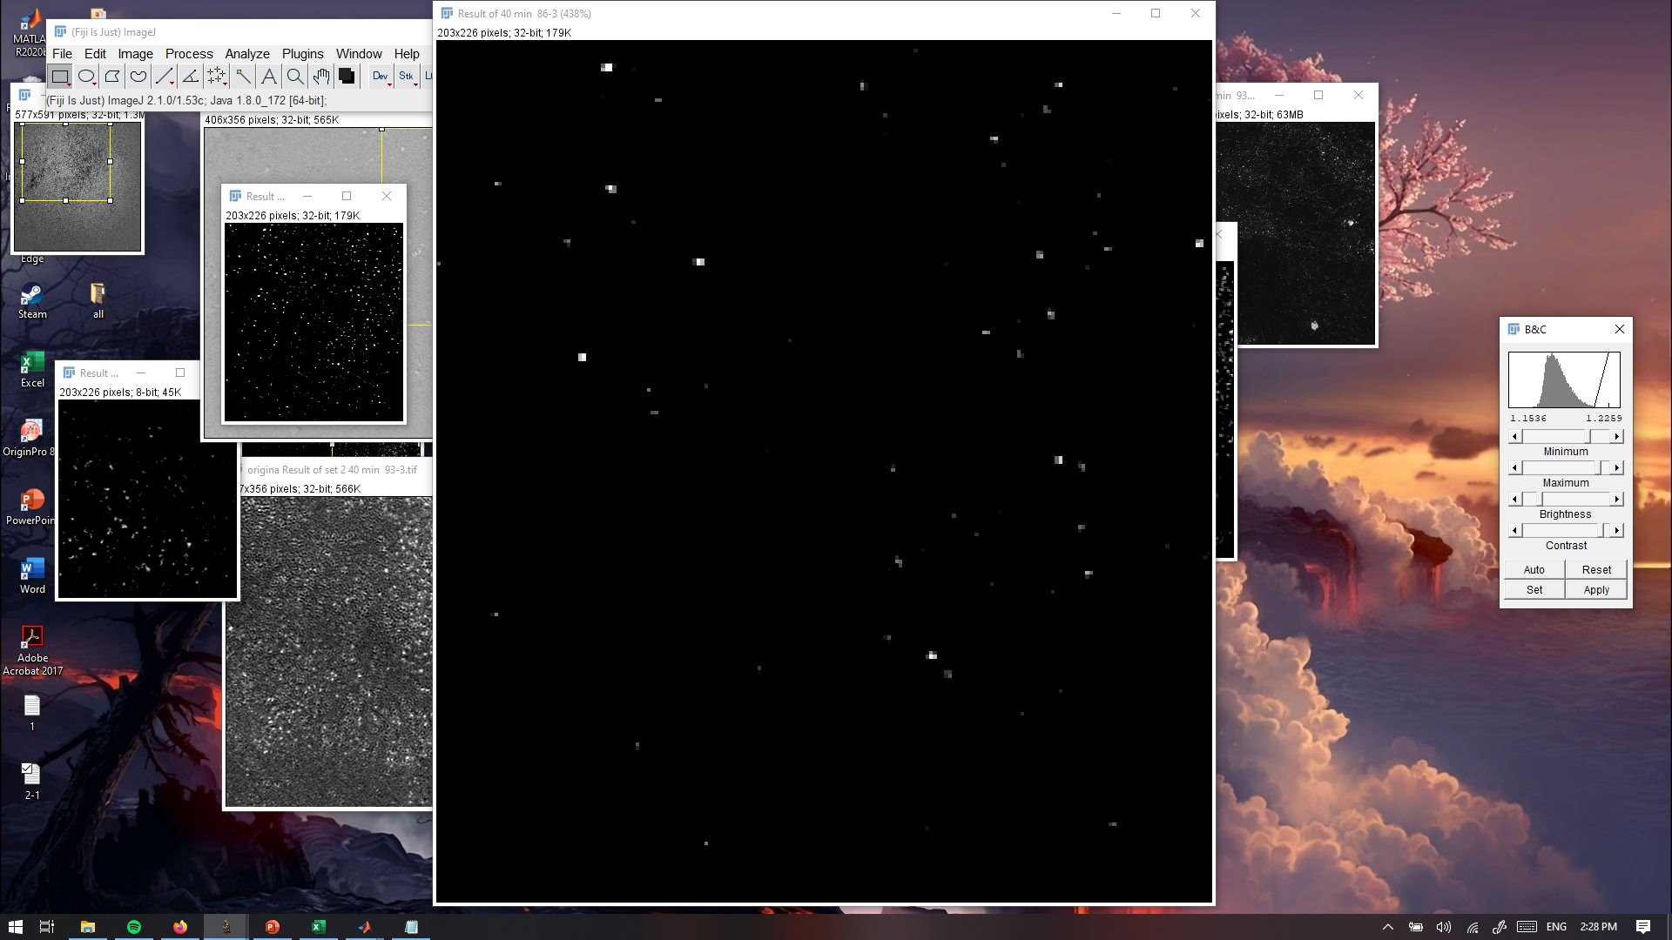
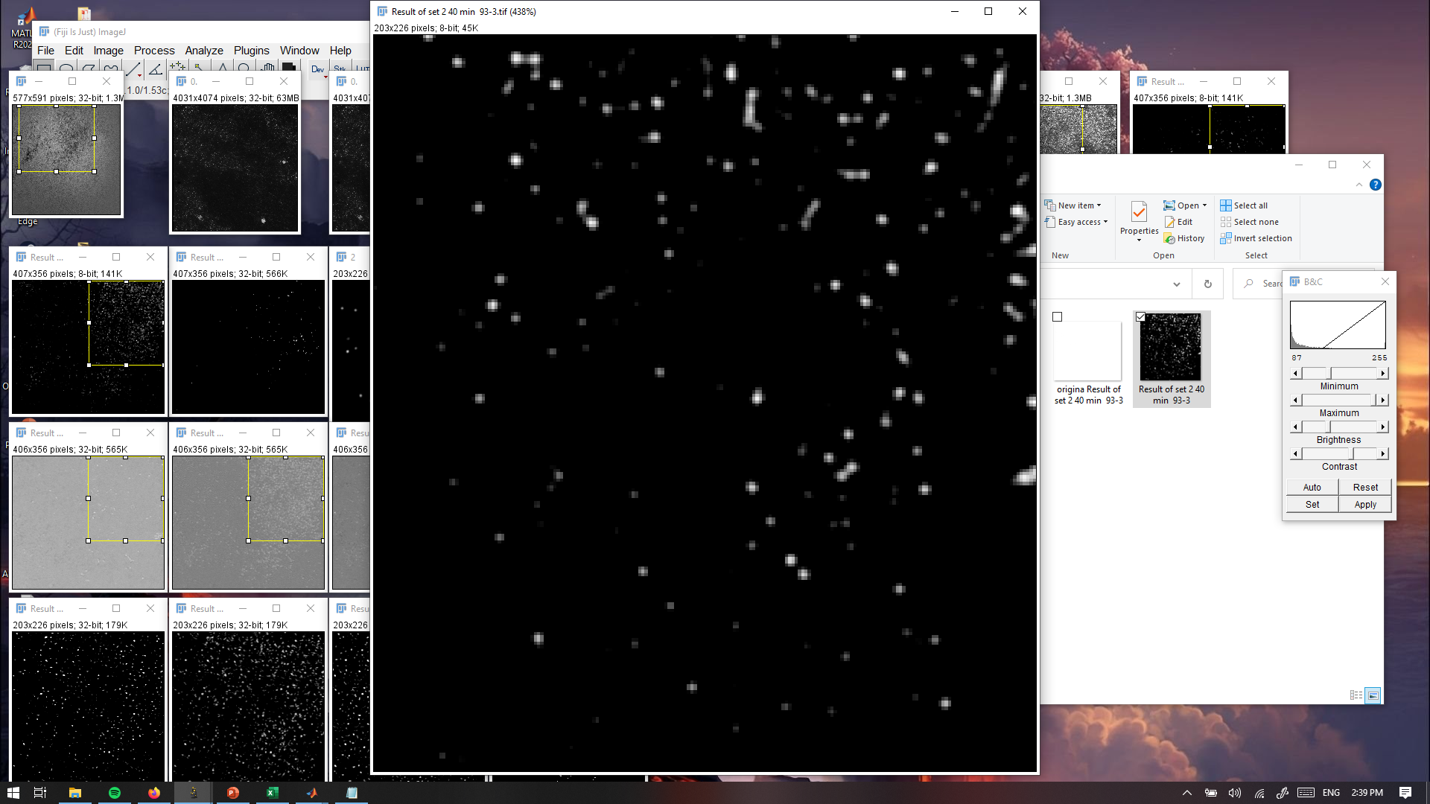
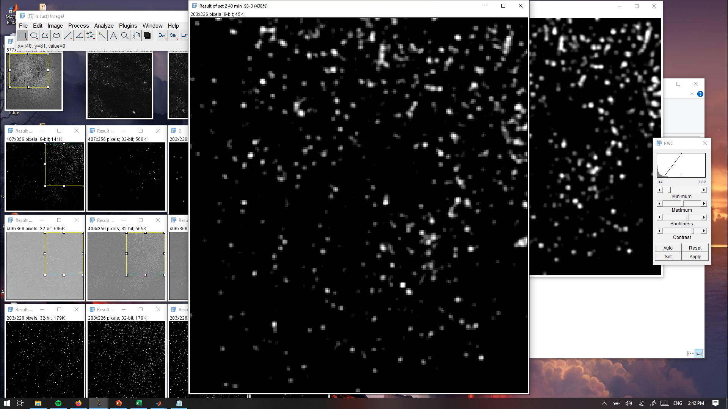
PANORAMA H460 (10%) and NHBE (90%) Mixture
PANORAMA
Time: 20 min
Count: 405
PANORAMA
Time: 45 min
Count: 677
PANORAMA
Time: 10 min
Count: 43
Scale bar: 5 µm

Slide 4
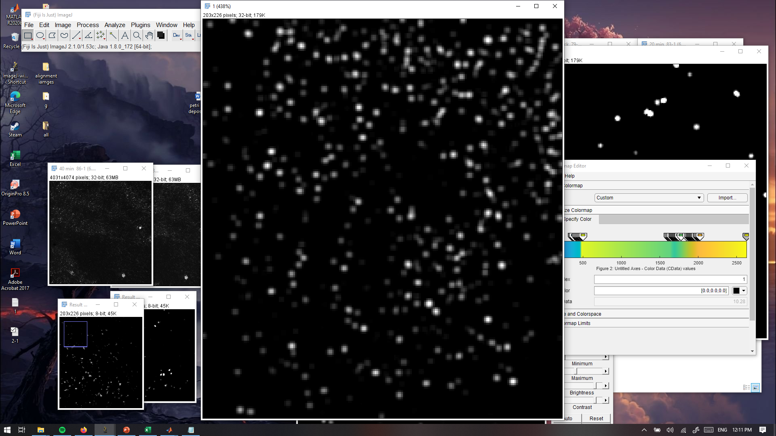
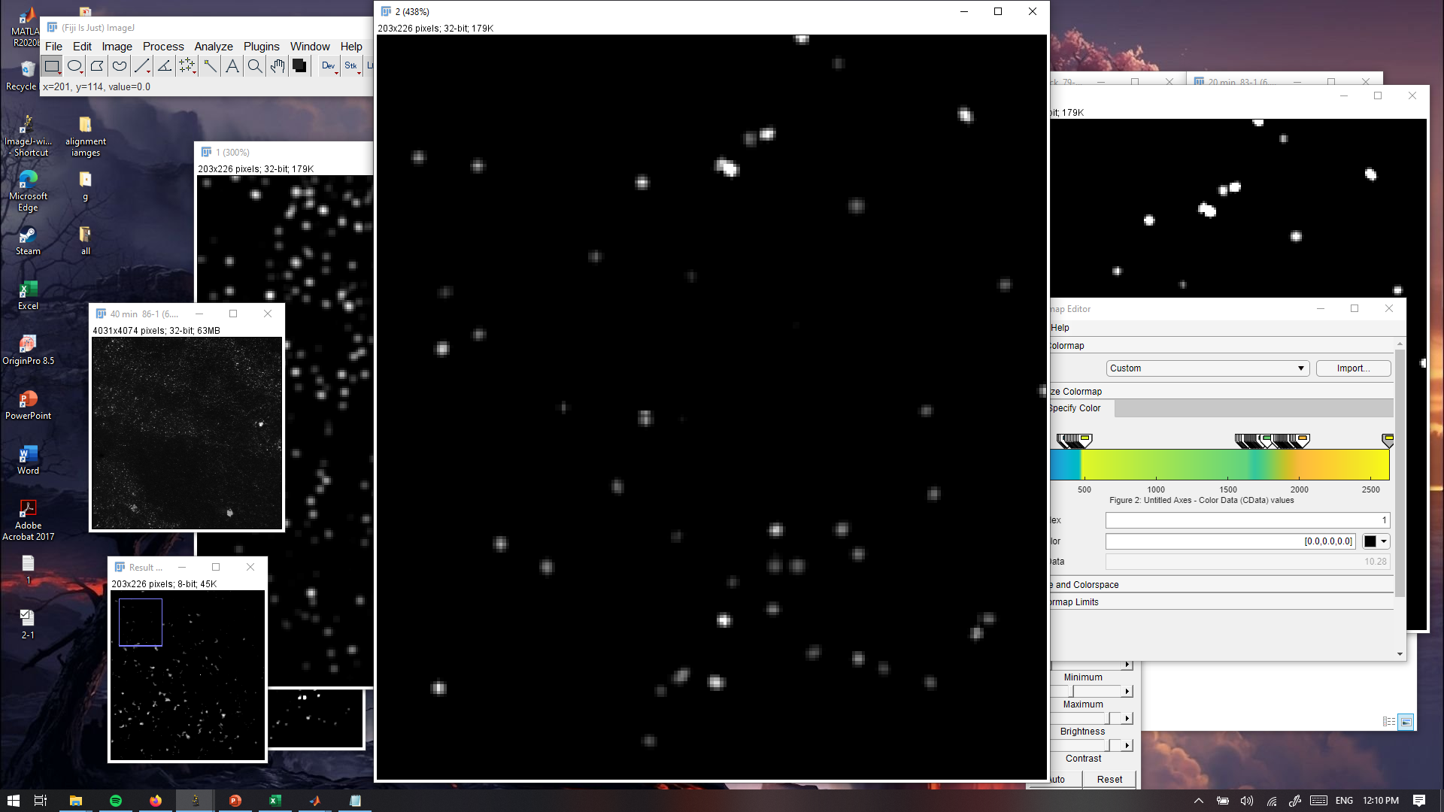
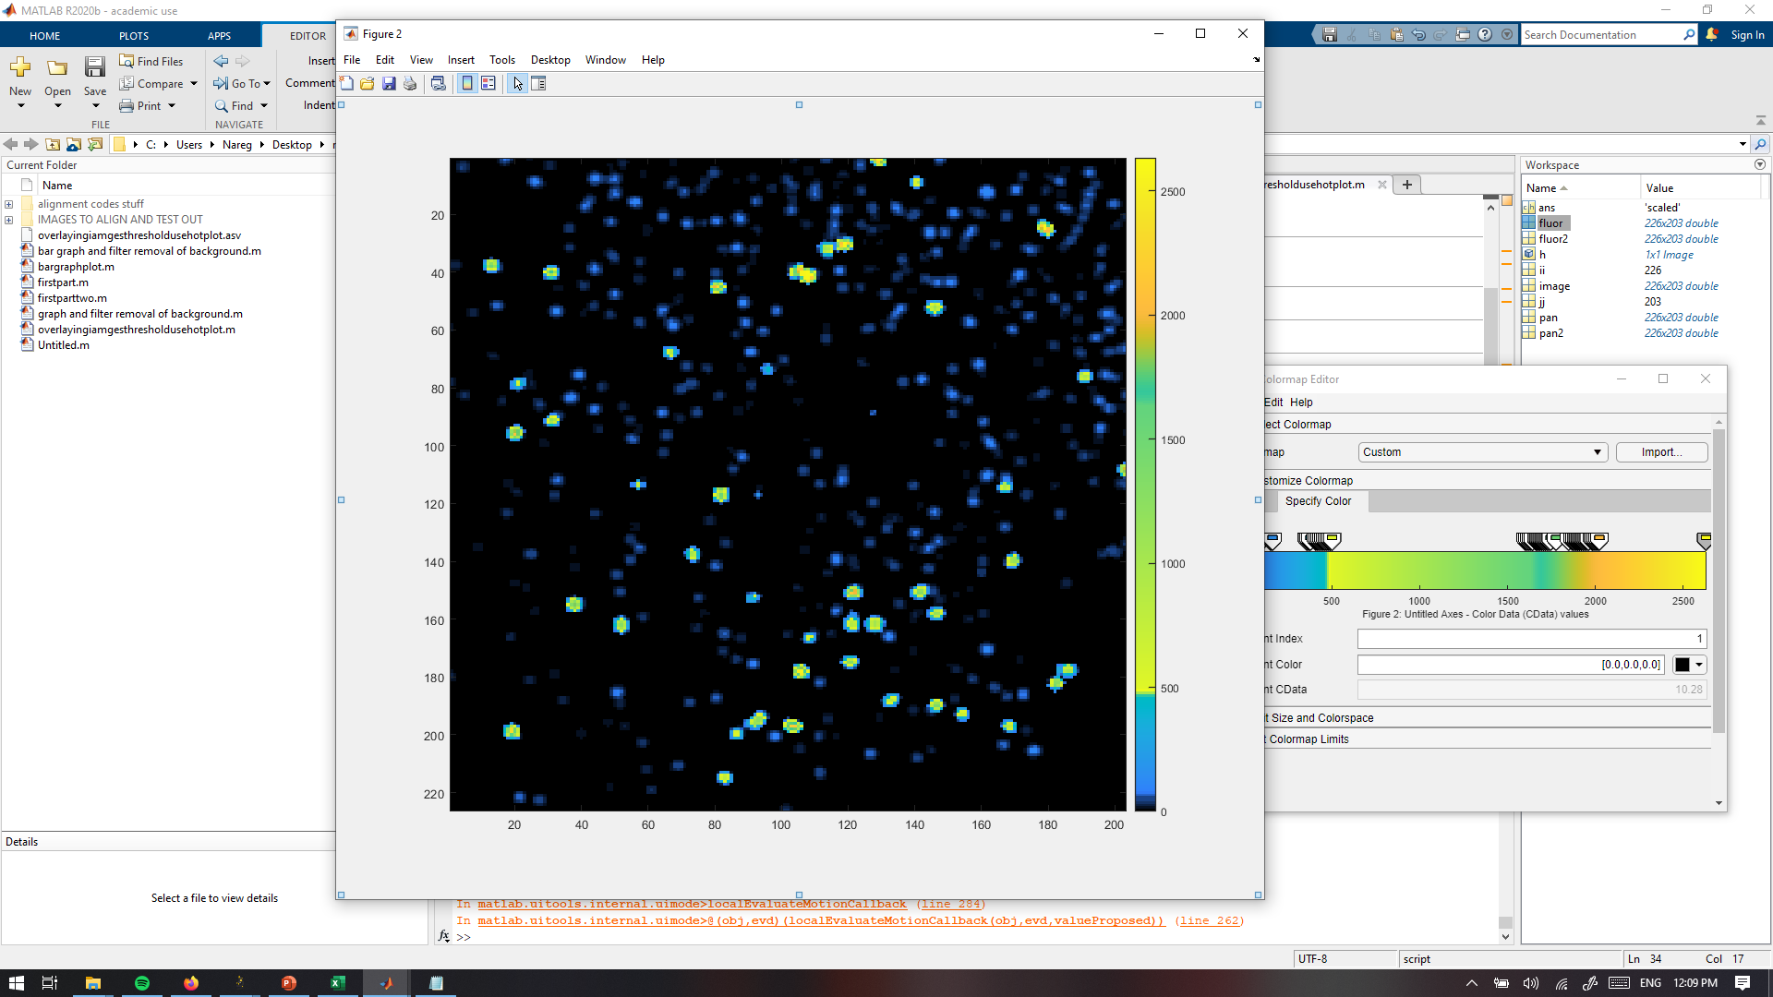
PANORAMA H460 (10%) and NHBE (90%) Mixture
PANORAMA (IR: 1.14 ± 0.056)
Time: 45 min wash
Count: 610
Fluorescence (403 ± 135)
Time: 45 min wash
Count: 47
Overlayed
Blue: PANORAMA
Yellow: PANORAMA and fluorescence
90 % of detected exosomes captured after wash
7 % of detected exosomes show mir-21 (7%/10%=70%)
Scale bar: 5 µm

Slide 5
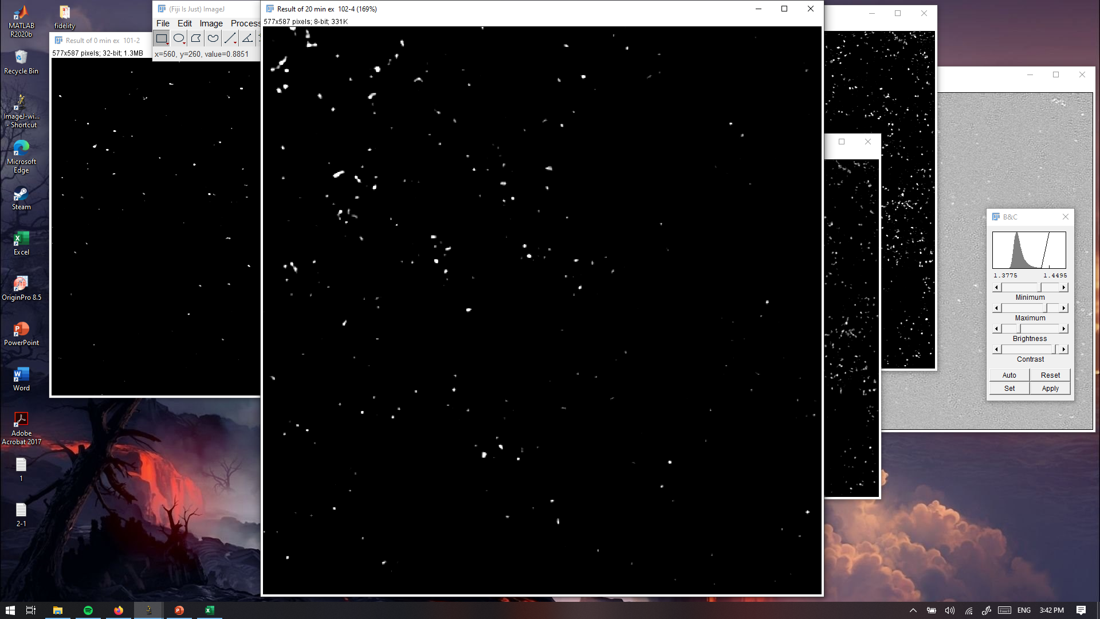
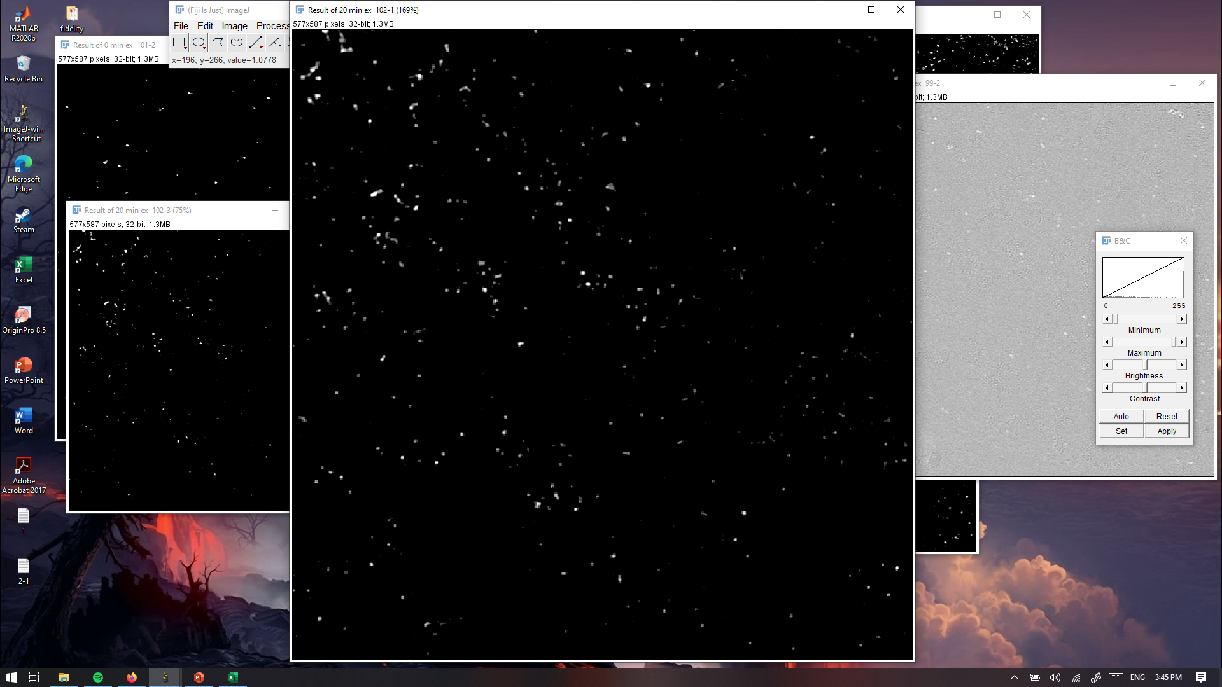
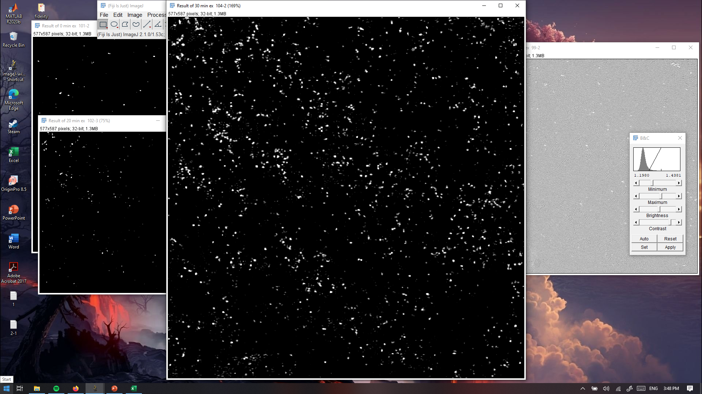

PANORAMA H460 (5%) and NHBE (95%) Mixture
PANORAMA
Time: 20 min
Count: 606
PANORAMA
Time: 45 min
Count:2311
PANORAMA
Time: 10 min
Count: 282
PANORAMA (IR:1.13 ± 0.069) Time: 45 min wash
Count: 2235
97 % of detected exosomes captured after wash
Scale bar: 20 µm

